Slide 1
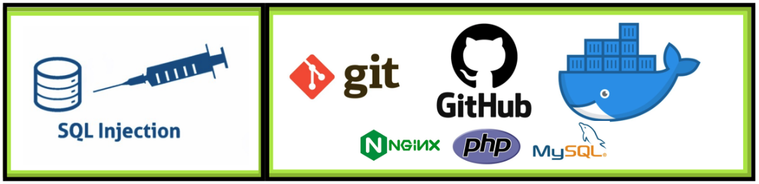
git/Docker/SQL Injection
Notes:
Thank Director Ingmire
Talk about my first job at PWPL 1995

Slide 2

Distributed version control system
Tracks changes to computer files
Great for coordinating programming teams working on source code and software development
Repositories can be:
Hosted on the web - GitHub. Great for open-source projects. Allows forking!
Hosted on-prem for Enterprise development within an organization
Benefits
Unlike SVN, users can work on on a file simultaneously as long as they are not working on the same line of code.
Contains merge functionality
Great resource for researching CVEs and other cyber exploitation projects.
Pre-installed on LINUX and Mac OS. Can be installed on MSFT
Notes:
Play Video

Slide 3
Installing git
Go to https://git-scm.com/download/win
Choose the first link “Click here to download” the latest 2.44.0 version
Choose Open
Follow install prompts along with me on my screen
In your user directory C:\Users\[your_username] create a directory called gitRepos
Open gitRepos in your Windows Explorer, it will be empty
Right-click on the empty directory and choose more options, then select “Open git bash here”
A UNIX BASH shell terminal window will open and you will be in the gitRepos directory
Type: git clone https://github.com/nmucyber/SQL_Injection
The repository will now be cloned to your machine
Notes:
Play Video

Slide 4

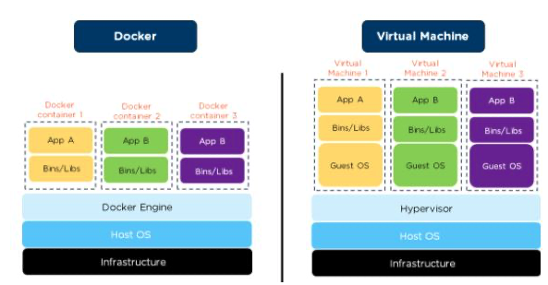
Docker
Treat your servers like ‘cattle’ not like ‘pets’
Think Virtual machines but lighter weight
Highly scalable and highly transportable
Notes:
Play Video

Slide 5
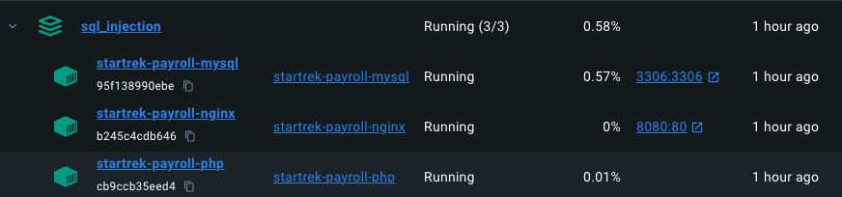
Docker
Applications are stored in containers
NGINX - Web Server
PHP - Server side scripting
MySQL - SQL Server Daemon
You can create multi-container applications on top of lightweight LINUX distros or simply the required Bins/Libs
Allows developers to have the same baseline on their local desktop as in production.
Can tie networks together and present ports to localhost for testing
Data in containers is not persistent, unless you want it to be.
Use Kubernetes to orchestrate/load balance/spawn production environments
Notes:
Play Video

Slide 6
Docker
Docker has a CLI and a GUI called Docker Desktop
Integrates with Docker Hub where people share open source containers and projects.
A lot of Docker Projects are also stored on Github
Clone repo with docker image
Use docker compose up –build
In terms of cybersecurity there are a lot of great Docker containers that you can use to explore vulnerabilities
VulnHub
Search a CVE of interest
From a DefSec perspective Docker Desktop also presents known vulnerabilities in the images you are using!
Let’s explore git/Docker and dig in.
Notes:
Play Video

Slide 7
Docker
Installing Docker Desktop
Docker requires the Windows subsystem for Linux (WSL)
Make sure windows is up to date
Go to the command prompt and type: wsl –install
If you are on Win10 you may have to run wsl --update
Since we will be using frontend and backend networking turn off Windows Defender Firewall for Public and Private networks.
Make sure you return the firewall settings to normal when we are done with the lab
Google Docker Desktop
Click on the first link in the results
Click Download for Windows
Open the installer after the download has been completed
Follow default prompts
Notes:
Play Video

Slide 8
Putting it all together
Git
clone the repository
demonstrate version control
add. / status / commit / push/ pull origin master
Docker
compose and the yml file
Starting/Stopping containers
Logs/Inspect/Mounts/Exec/Files/Stats
The vulnerability directly passing $POST to query
Example and logs
Using sqlmap on Kali LINUX
The remediation. Use PHP PDO library and a prepared statement
File compare and change
Example and logs
Revisit website / Revisit sqlmap
Notes:
Play Video

Slide 9
Wrap Up
Questions
Thank You
Beer!

